Slide 1

Using Secondary Data & Online Information Databases

Slide 2
Reminder: Proposal
The proposal is due next week in the Classroom Lab – counts 5%.
Late proposals will de deducted 10% unless written extension.
Follow the guidelines in the Project handout.

Slide 3
Proposal: Types of Research
Secondary Research
Objective, Sub-Objectives, Methodology
Qualitative Research
2.1 In-Depth Interviews
Objective, Sub-Objectives, Methodology
2.2 Focus Group
Objective, Sub-Objectives, Methodology
Qualitative Research
Objective, Sub-Objectives, Methodology
If more than one study
treat separately

Slide 4
Learning Outcomes …
To find and use existing databases to:
Research an industry
Research a specific company
Segment your customers

Slide 5
Open-source vs. Library databases
Google | Library Databases
Visible Web (Shallow) | Invisible web (Deep)
Public material | “Gated” material (not free access)
Press releases | Journals, news, specialty data
Informal (no evaluation) | Controlled material (evaluation applied)
Imprecise searching | Powerful search interfaces
Library purchases access to specific databases of market research reports

Slide 6
Researching an Industry

Slide 7

Start with a Business Problem
Assume that you are interested in starting your own vineyard and winery in the Okanagan.
Your business problem is to determine if such a venture is economically viable.

Slide 8

Your turn…
What are some of your specific Research Objectives going to be?
Turn to your neighbour and come up with min. three Research Objectives.
Notes:
Stop here and get the class to come up with at least three good research objectives. Next three slides include some likely objectives that would have to be met.

Slide 9

Some Research Objectives
Gain an understanding of the current wine and alcoholic beverage industry in BC & Canada.
Gain an understanding of trends in the wine industry locally, nationally and internationally.
Notes:
Gain an understanding of the current wine and alcoholic beverage industry in BC & Canada.
Gain an understanding of trends in the wine industry locally, nationally and internationally.

Slide 10

Some Research Objectives
Gain an understanding of the regulatory environment in BC.
Determine current real estate prices in wine-growing areas of the Okanagan, BC.
Notes:
Gain an understanding of the regulatory environment in BC.
Determine current real estate prices in wine-growing areas of the Okanagan, BC.

Slide 11

Some Research Objectives
Identify competitors, products and pricing.
Gain an understanding of fixed and variable costs.
Determine the economic feasibility of your idea.
Notes:
Identify competitors, products and pricing.
Gain an understanding of fixed and variable costs.
Determine the economic feasibility of your idea.

Slide 12
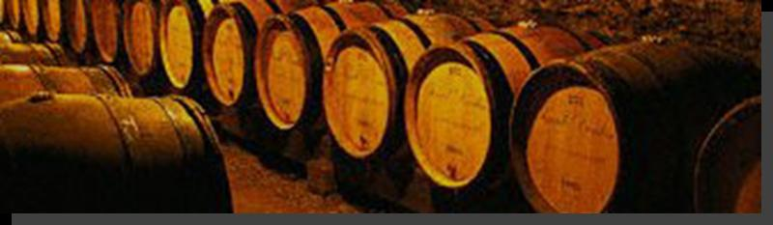
Next, identify Information Sources
Where would you look for information on the wine and alcoholic beverage industry in BC and Canada?
Notes:
STOP HERE AND Get class to think of some potential sources of wine industry information before moving on.

Slide 13
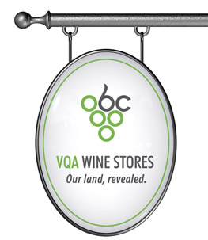



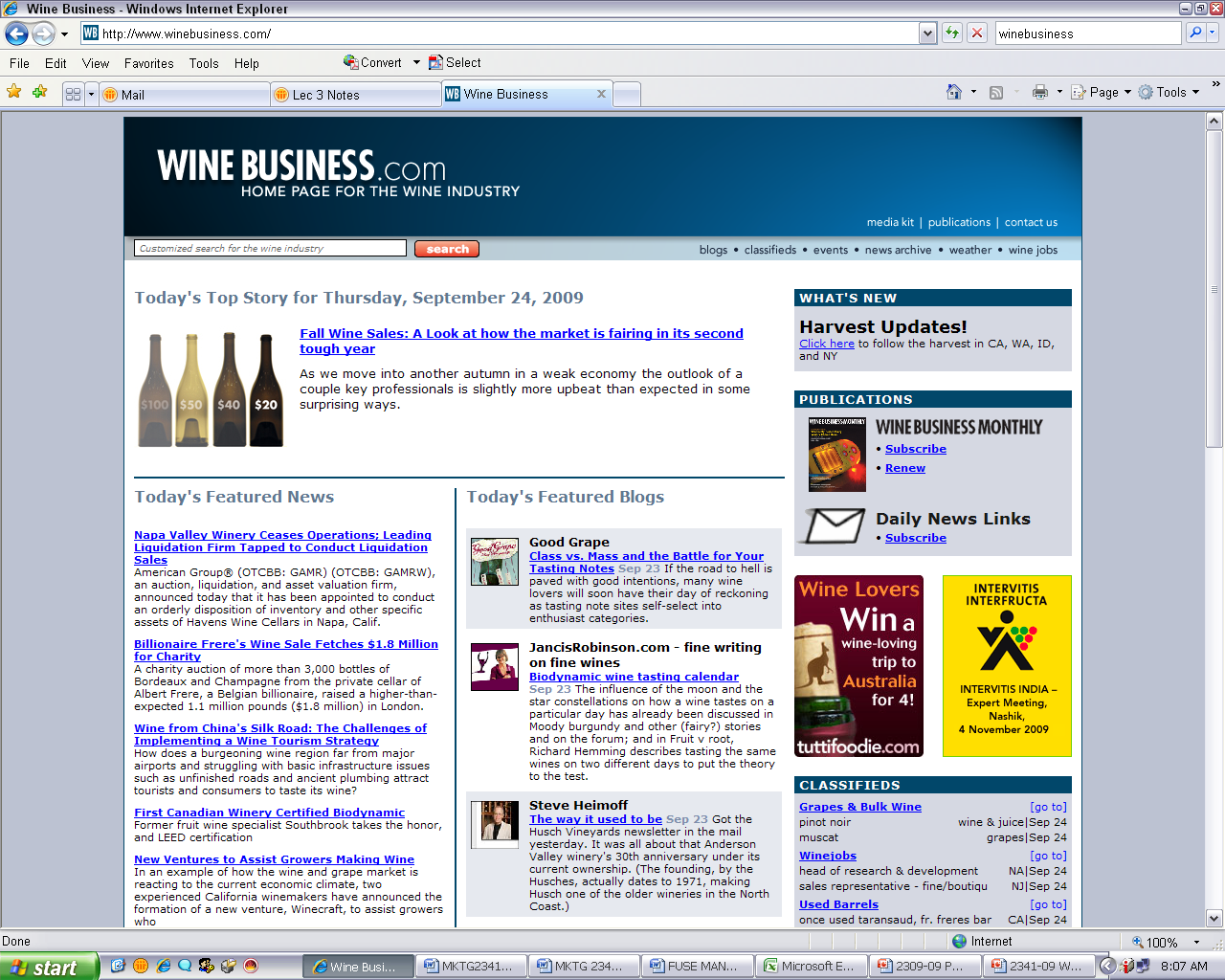
Sources for the Wine Industry
BC Wine Authority
BC Wine Institute
Grape Growers of BC
Association of BC Wine Growers
Canadian Vintners
Winebusiness.com
Wines of Ontario

Slide 14
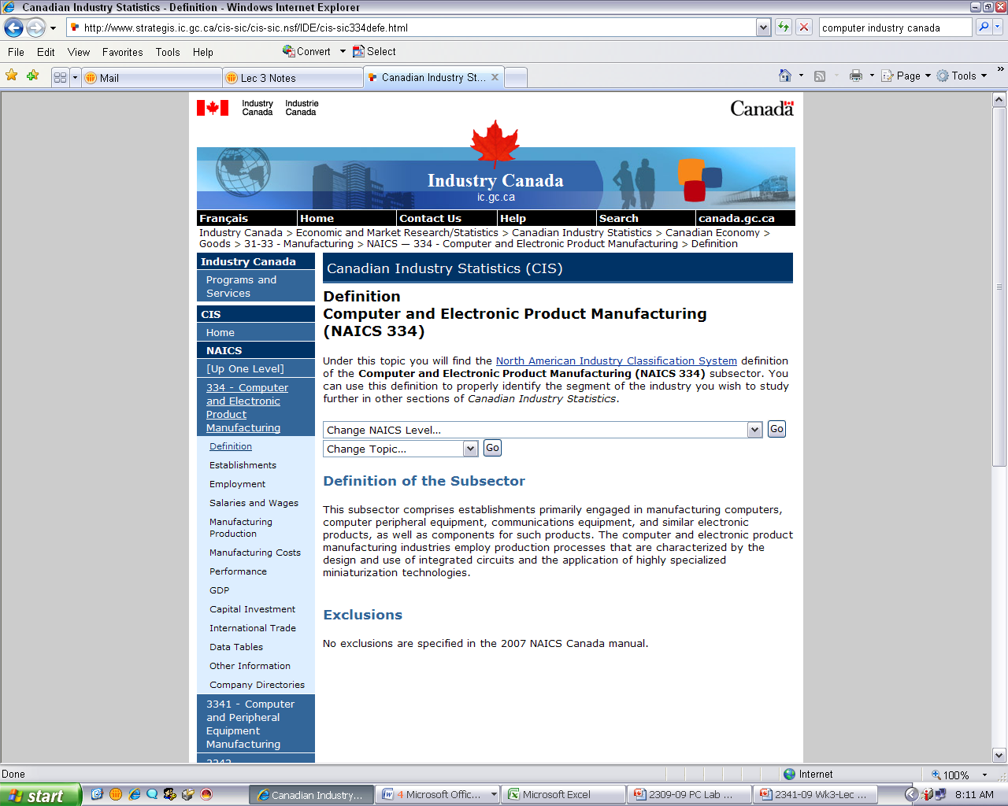
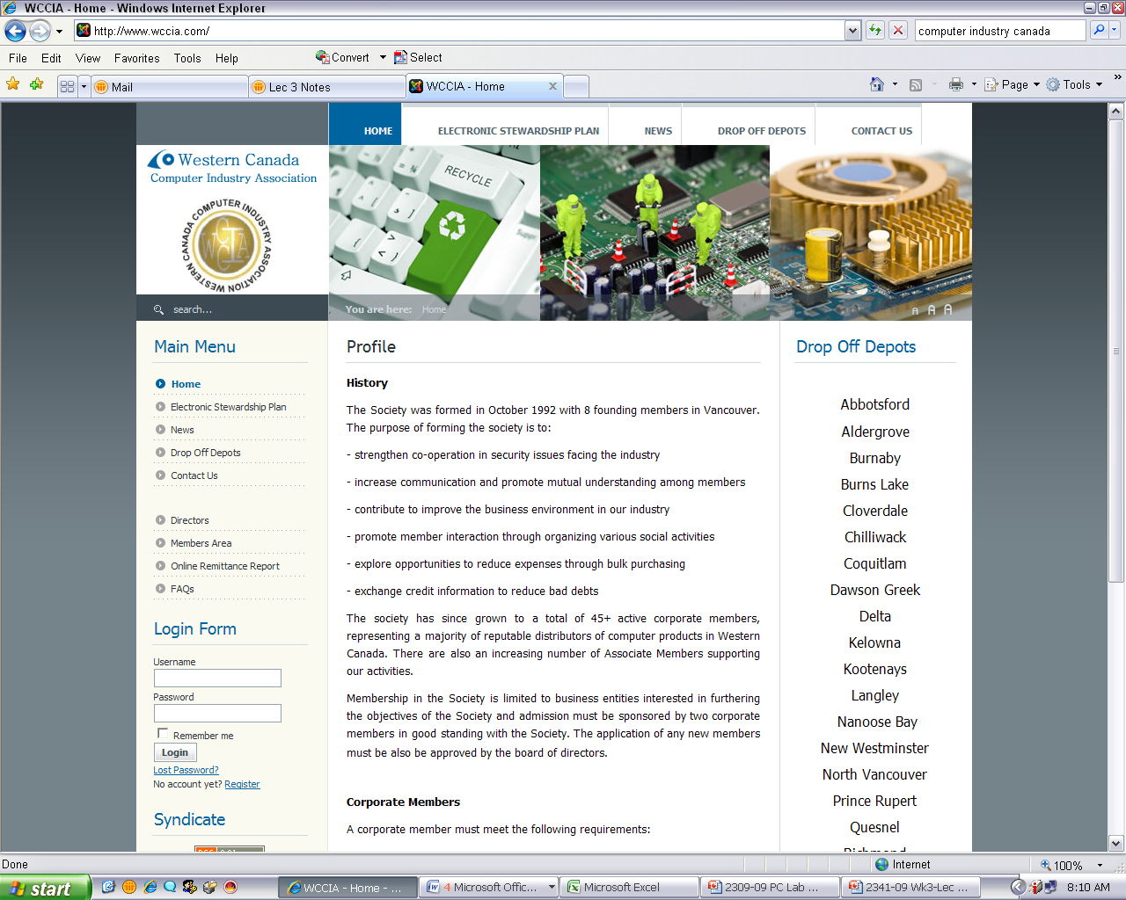
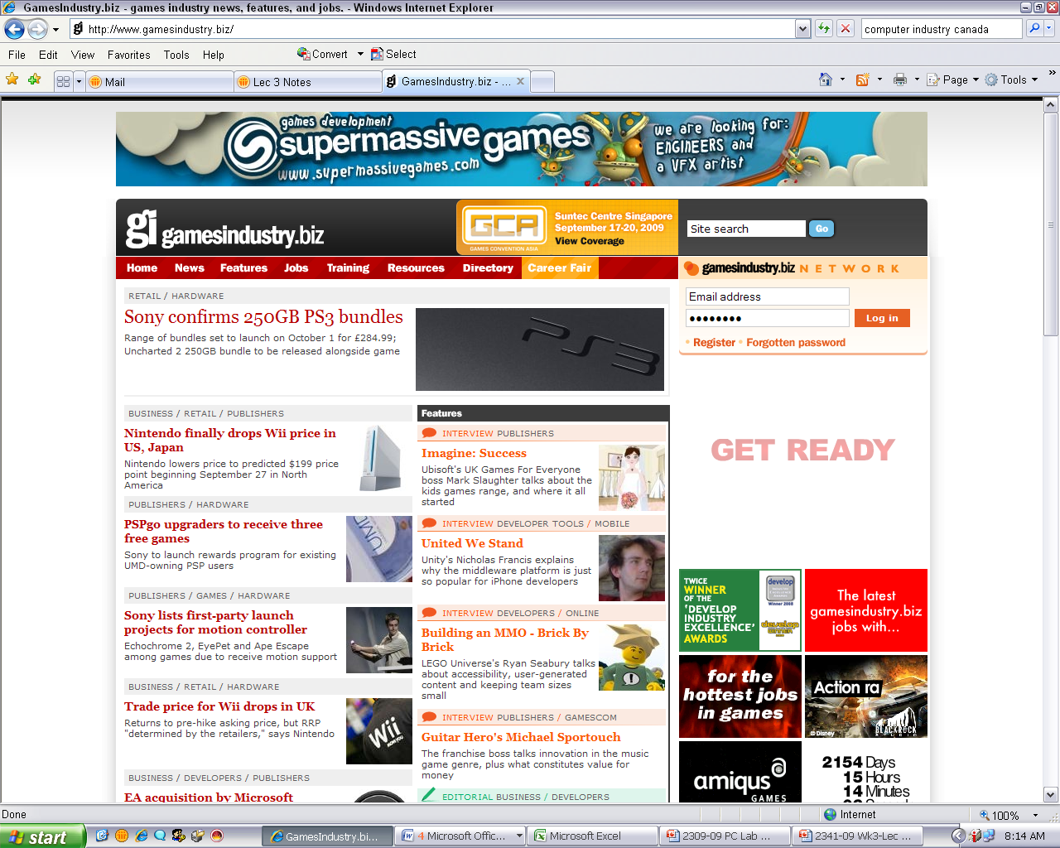
Sources for your Industry
Where would you look for information on the industry that you are interested in?
Notes:
STUDENTS TO THINK ABOUT POTENTIAL SOURCES OF INFORMATION FOR THEIR PROJECTS/INDUSTRY

Slide 15
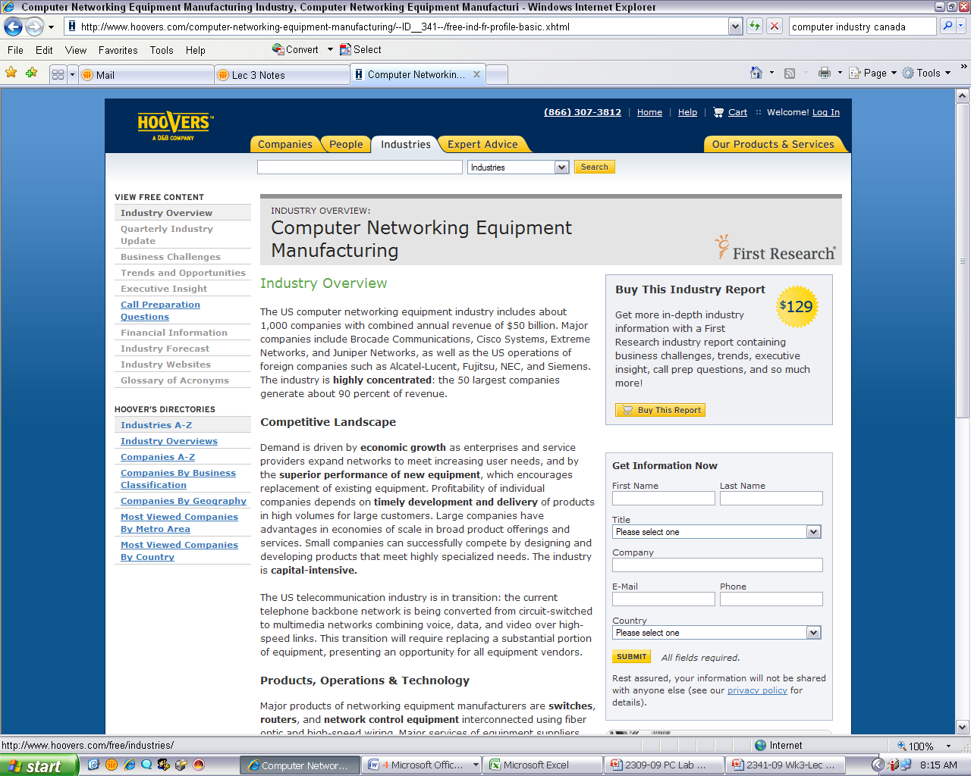
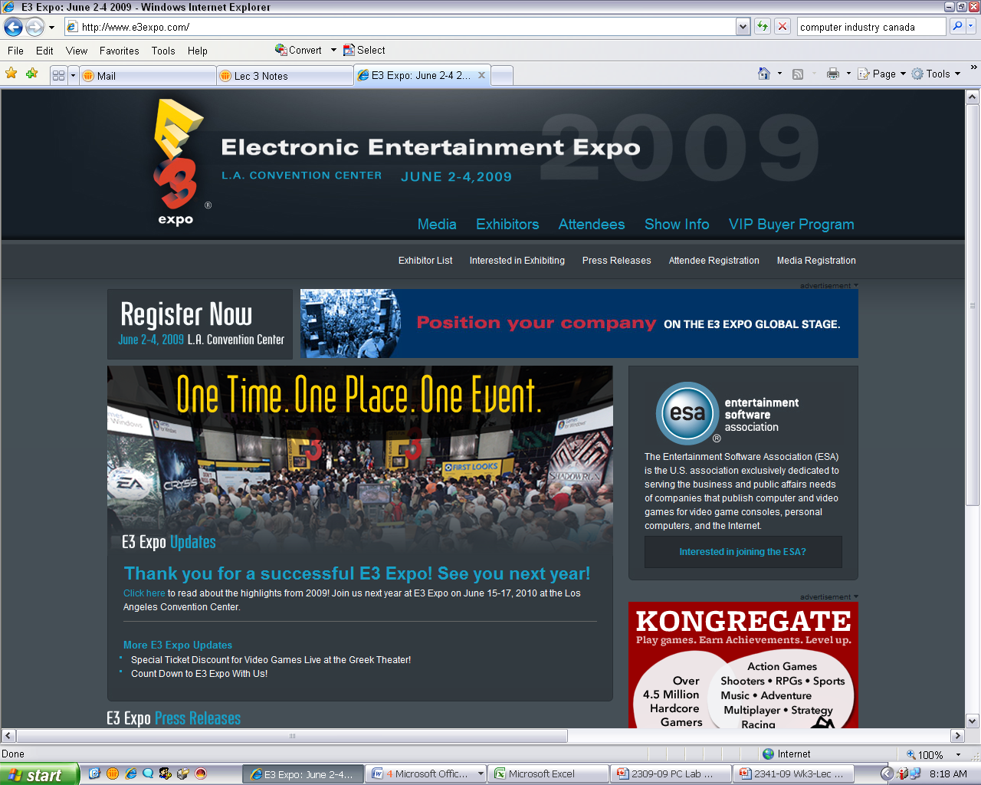
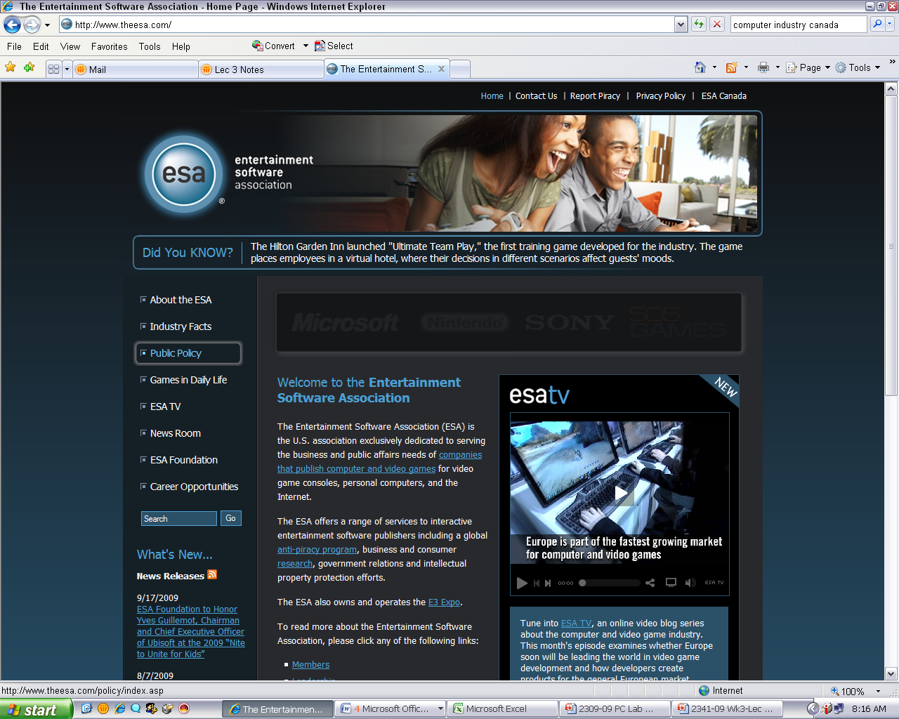
Sources for your Industry

Slide 16
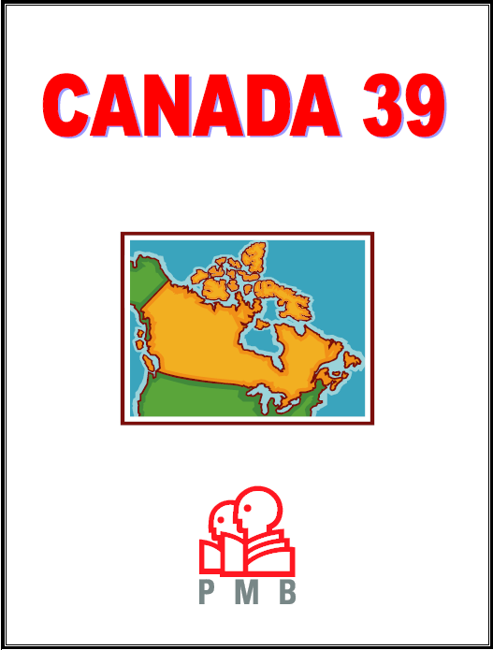
Sources of Industry Information
Government Statistics
Canada.gc.ca, statcan.gc.ca, ic.gc.ca
Commercial Databases
GMID, Pcensus, Prizm, Proquest
Media Tracking
Print Measurement Bureau
Trade Associations
Trade Journals
Company Websites
Books, Texts, and so on
Notes:
http://www.pmb.ca
PMB Print Measurement Bureau is Canada's leading syndicated study for single-source data on print readership, non-print media exposure, product usage and lifestyles. Published a lifestyle study called Canada 39 (grouping Canada into 39 segments – of which 5 are in BC)
Its reputation is based on over 35 years of accurate, in-depth measurement of Canadian consumer behaviour.
PMB is a non-profit organization, representing the interests of Canadian publishers, advertising agencies, advertisers and other companies.

Slide 17

NAICS: North American Industry Classification System
NAICS has replaced the old SIC (Standard Industry Code) system.
NAICS gives every type of company in every industry a unique code.
6-digit code means more specific identification of companies.
US, Canada, and Mexico.
Notes:
North American Industry Classification System (NAICS)
6 digit code developed and adopted by US, Canada, and Mexico.

Slide 18

NAICS
Hierarchical Structure
XX Industry Sector (n=20)
XXX Industry sub-sector
XXXX Industry group
XXXXX Specific type of business
XXXXXX US, CDN, MEX.

Slide 19
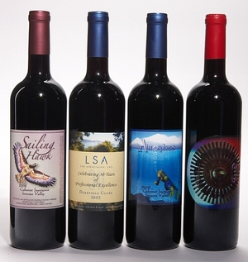
NAICS – Ex: Wine
Hierarchical Structure
31 Manufacturing
312 Beverage and Tobacco Product Manufacturing
3121 Beverage Manufacturing
31213 Wineries
31213X Wineries in US, CDN, MEX

Slide 20


Government Business Statistics
Governments gather statistics on just about everything - economic, demographic and business/industry.
Governments use this information to make decisions.
…and so can you!

Slide 21
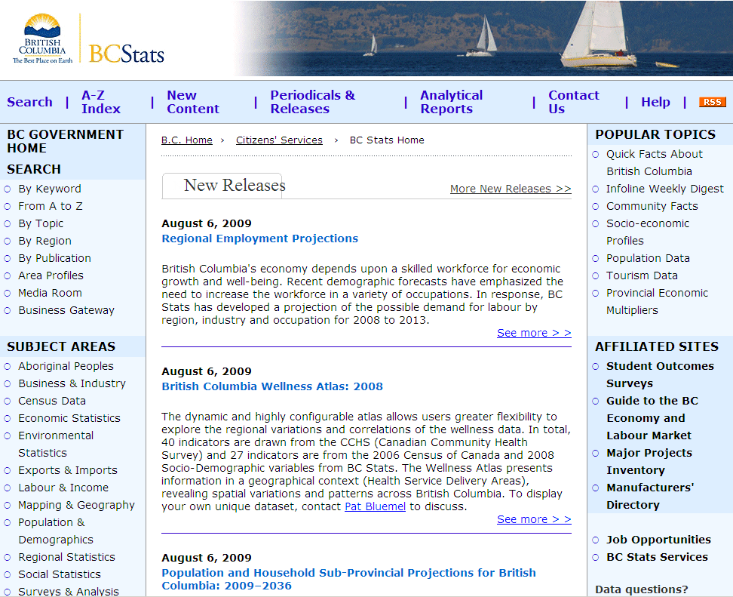
Click on Economic Stats.
Scroll down to Construction & Housing.
Download stats to Excel.
Notes:
Click on Economic Stats, Scroll down to Construction and Housing and download statistics to Excel

Slide 22
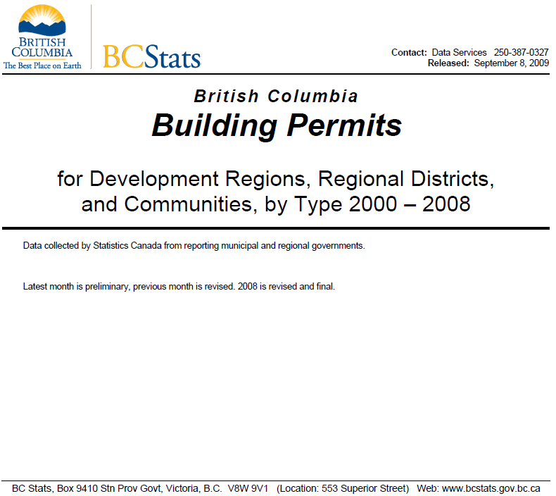
BC Stats Report
Download Report on Building Permits.
Notes:
http://www.bcstats.gov.bc.ca/data/dd/handout/BUILD.pdf
47 page report

Slide 23

Federal Government Statistics
Most common federal government sources of information are Stats Canada & Industry Canada
Stats Canada is responsible for conducting Canada’s regular Census.
Provides information on an enormous variety of topics related to both people and businesses.

Slide 24

Canada Census
Best place to find demographics for specific geographic locations:
Income
Age
Education
Marital status
Family
Occupation
Dwelling (size, value)
Religion
Ethnicity

Slide 25
Stats Canada Online Publications
Spending patterns, detailed information on industries, articles on social trends.
Access to full-text Stats Can titles:
Retail Trade,
Canadian Social Trends
Canadian Economic Observer
Spending Patterns in Canada
Food Consumption in Canada

Slide 26
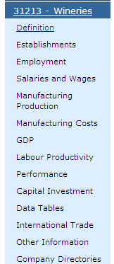

Industry Canada
NAICS code
Industry Canada’s portal to business information.
Data on industry, trade, market, directory and consumer information.
Notes:
26
Another reputable source of information is the government:
The government is a top source of high quality information. Industry reports include a great deal of market information, including statistics.

Slide 27

Other Market Research Databases (BCIT Library access)
GMID – Euromonitor
Country level information: forecasts, market shares, competitive landscape, key players, etc.

Slide 28


New to BCIT Library
Dun & Bradstreet: sales & marketing databases, industry and company database. Also fee-based consulting service.
Hoover’s: Forecasts, market shares, CRM, competitive landscape, statistics, distribution channels, regulations.

Slide 29

Article Databases (BCIT Library)
Full articles or abstracts
Reports/articles on business/industry
Business Source Premier.
Datamonitor via Business Source Premier
ABI Inform / Canadian Newsstand.

Slide 30
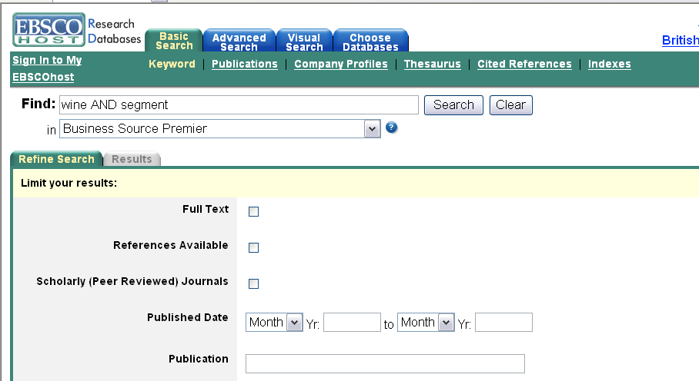
Business Source Premier
Notes:
After hitting search, click “Wine Industry” on left side bar.

Slide 31
Gartner Reports
Sign-in through my.bcit.ca
Research, analysis and interpretation of the business of IT.
60,000+ clients
4,000 associates, including 1,200 research analysts and consultants in 80 countries.
Offers Data Reports and consulting services.

Slide 32
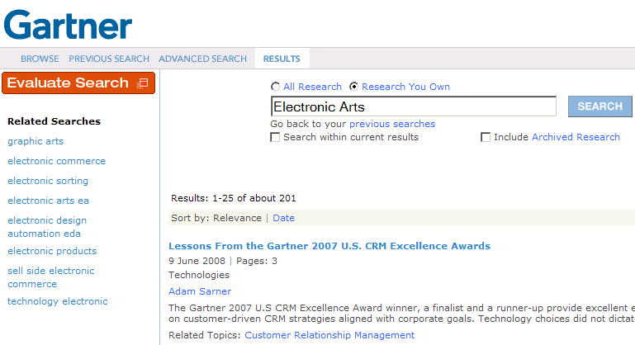
Gartner’s Reports
Search for EA
Lots of results

Slide 33
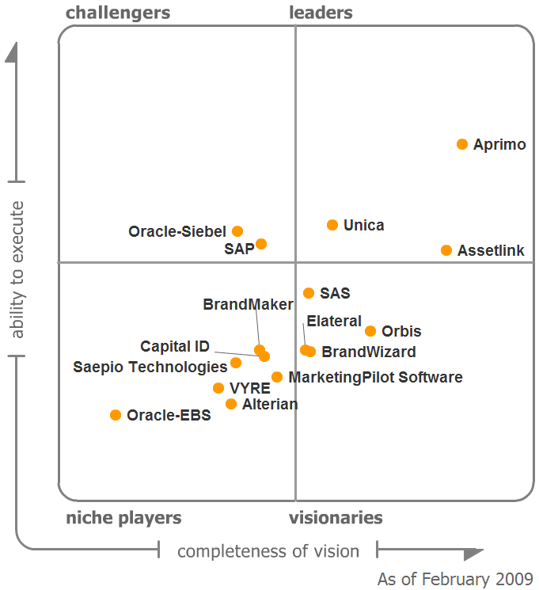
Gartner’s Magic Quadrant
Magic Quadrant for Marketing Resource Management

Slide 34



Other Industry-Related Market Research Databases (fee-based)
Bloomberg: news and data about publicly traded companies.
Conference Board of Canada: information on economic trends, organizational performance and public policy issues.
Marketresearch.com: pay-for-service market research reports, general to specific.

Slide 35
Identifying Industry Regulatory Information

Slide 36

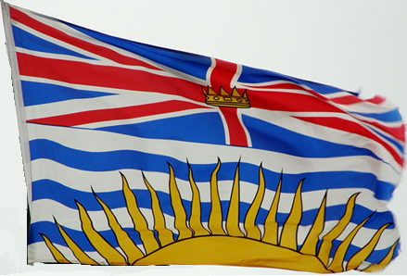
Regulatory Information Sources
Where would you
Research Regulations?
Federal Government
Provincial Government
Industry Associations (e.g., BC Wine Authority, BC Wine Institute, Grape Growers of BC)
Notes:
36

Slide 37
Key Points
Searches are organic processes start with a plan, but be prepared to follow productive lines of inquiry.
Think outside the box!
Use different search strategies, engines and tools.
Look for and explore links included on reputable websites.

Slide 38
Researching a Specific Company

Slide 39
Research Individual Companies
Many of the same resources that you used when researching the industry as a whole.
When considering starting your own company, it helps to look at both existing and ‘extinct’ companies.
To see how they have done it, become successful, failed, etc.

Slide 40
Research Individual Companies
More information is available for public companies vs. private companies.
Public companies:
Required by law to make their books available.
There is more interest in, and therefore more information about, companies that people can invest in.
www.sedar.com – SEDAR (for Canada)
www.sec.gov/edgarhp.htm – EDGAR (for US)
Notes:
SEDAR: The System for Electronic Document Analysis and Retrieval is a mandatory document filing and retrieval system for Canadian public companies. SEDAR is operated by the Canadian Securities Administrators, a coordinating body comprising the 13 Canadian provincial and territorial securities commissions.
EDGAR: The US counterpart to SEDAR.

Slide 41
Segment Your Customers

Slide 42

Collecting information to get inside your customer’s head

Slide 43
Segmentation Variables
Demographic
Sex and age
Income
Occupation
Education
Ethnicity
Living situation
Psychographic
Attitudes
Opinions
Interests
Motives
Lifestyles
Geographic
Location
Access
Climate
Density
Resources
Behavioural
Product-usage characteristics:
usage rate
benefits sought

Slide 44
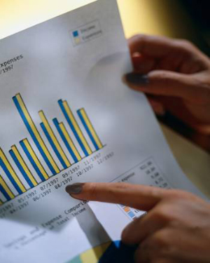
Main Sources of Secondary Consumer Information
Internal secondary data
If existent and available
External secondary data:
Government (census data)
Commercial databases
Association resources
Reference books
Trade journals

Slide 45
Internal Secondary Data
Data collected by individual companies:
Customer characteristics and purchase behaviour (CRM).
PIPEDA: Personal Information Protection and Electronic Documents Act.
Ethical issues.
Notes:
As of January 1, 2004, all Canadian businesses are required to comply with the privacy principles set out by PIPEDA.
Under PIPEDA, personal information must be:
collected with consent and for a reasonable purpose
used and disclosed for the limited purpose for which it was collected
accurate
accessible for inspection and correction
stored securely

Slide 46
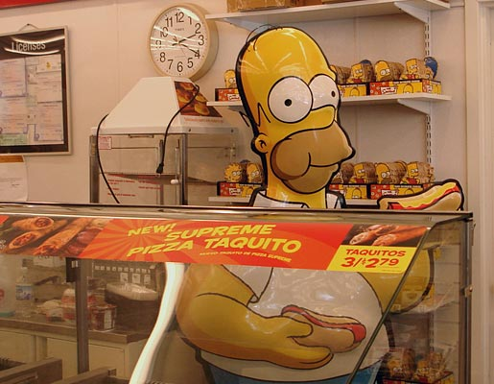
Internal Secondary Data
Ethical issues:
What information do you collect?
How much do you need to know?
How will you use the information?

Slide 47
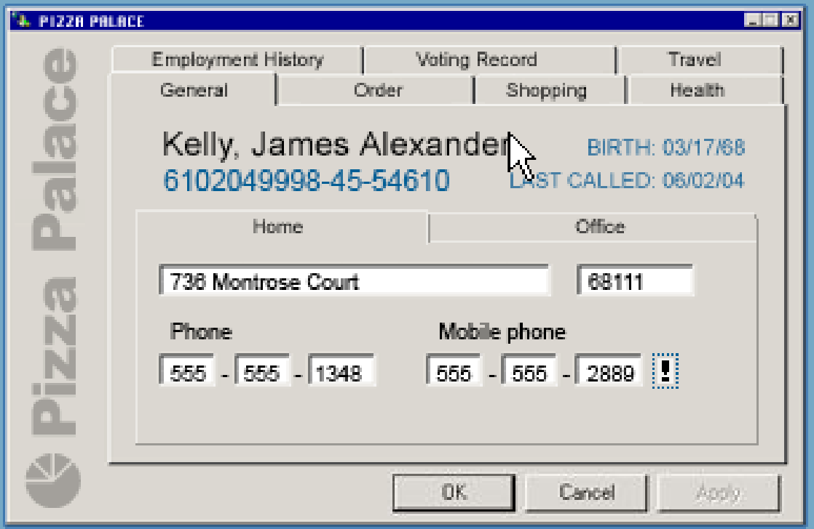
Ethical Considerations
Notes:
Link contains a funny clip about Customer Relation Management at a pizza shop - 3 min: http://www.aclu.org/pizza/images/screen.swf
Or http://www.youtube.com/watch?v=RNJl9EEcsoE
Or http://www.youtube.com/watch?v=-4LtYMNl4yw
Or http://www.aclu.org/pizza/index.html?orgid=EA071904&MX=1414&H=1
Source: American Civil Liberty Union
“Government programs and private-sector data collection are destroying our privacy, pushing us towards a 24-hour surveillance society. We are facing a flood of powerful new technologies that expand the potential for centralized monitoring, an executive branch aggressively seeking new powers to spy on citizens, a docile Congress and courts, as well as a cadre of mega-corporations that are willing to become extensions of the surveillance state. We confront the possibility of a dark future where our every move, our every transaction, our every communication is recorded, compiled, and stored away, ready for access by the authorities whenever they want.”

Slide 48
External Secondary Data
Government Sources
All levels of government collect data about residents in their jurisdictions:
Statistics Canada www.statcan.ca
BC Stats www.bcstats.gov.bc.ca/
City of Vancouver www.city.vancouver.bc.ca/

Slide 49


Types of Standardized Information
Standardized services - standardized marketing research process that is used to generate information for a particular user.
ACNielsen SoundScan tracks downloaded music.
Polk Canada specializing in the automotive industry.

Slide 50

Types of Standardized Information
Syndicated data - collected in a standard format and made available to subscribers.
Ex: Ipsos-Reid BC Report
Notes:
The BC Reid Report provides the most comprehensive and in-depth analysis of public opinion in British Columbia. This survey of British Columbians examines corporate, political, and social trends four times a year, providing insights into current issues affecting the province.
http://www.angusreid.com/pdf/publicat/bc.pdf

Slide 51
Standardized Information
Syndicated studies that look at large populations often segment those markets and compare and contrast data for each segment.
Companies use their segmentation to differentiate themselves from competition.
Segments can be determined by a variety of different variables…

Slide 52

Geo-demographics
Geo-demographics: Classification of usually small, geographic areas in terms of the characteristics of their inhabitants.
Ex: PRIZM C2 from Environics.
Defines every neighborhood in Canada & US in 66 different segments.
Notes:
52
PRIZM CE is the Canadian version from Environics Analytics
Premise – “Birds of a feather flock together”

Slide 53

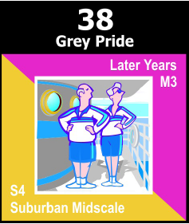
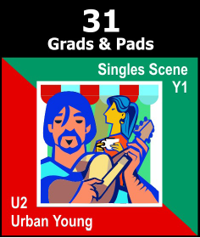
Segmentation w/ PRIZM C2
Money & Brains
Grey Pride
Grads & Pads
Upscale, educated professionals and their families
Looking not only for fulfillment but also for fun as they age.
Midscale suburban apartment-dwelling seniors.
Collecting coins and doing crafts.
Watch “Dr. Phil” & “Oprah.”
Young midscale urban singles.
nation’s most liberal lifestyle
night owls, frequent health clubs, rock concerts, art galleries

Slide 54
Other Commercial Sources
Demographic & Lifestyle
Optima Marketing, Environics Analytics
Consumer Attitudes & Public Opinions
Pollara, Compas, IPSOS Canada
Consumption & Purchasing Data
NPD Canada (National eating trends & much more).
Advertising Research
BBM Canada, The Radio Marketing Bureau, Nielsen Media Research, Leger Marketing
Notes:
Pollara: Canadian owned public opinion and market research firm. Offers consulting services including questionnaire development, research methodology, etc.
Compas: Canadian polling and consumer research

Slide 55
Multiple Sources of Data
Segment Profiles (Syndicated data)
Market Trends (Industry data)
Competitive Intelligence (Co data)
Consumer Surveys (Customer data)
Winning Marketing Strategy
Data for Blasted Church …

Slide 56
Review – Select Resources
Define what you’re looking for.
Identify which resources work best for your need.
Search the resources.
Understand resource coverage and limitations.
Accept that some information may not be available.

Slide 57
Review – Select Resources
Articles let you explore a wide range of topics.
Company filings let you research the environment.
Market Research / Industry Profiles give you a broad overview.
Government Resources give you statistics, industry profiles, consumer demographics & regulatory information.

Slide 58
Review – Write & Cite
Keep track of your secondary sources.
Use APA or MLA Reference format.
If you have questions about citation rules, use the library guides:
http://www.bcit.ca/library/guides/

Slide 59
Summary!
First, we looked at broad industry trends.
Then, narrowed our scope to include certain types of wineries (i.e., smaller wineries as opposed to large ones).
Finally, looked at individual wineries.
Used a wide variety of information sources at each level of our inquiry.

